Slide 1
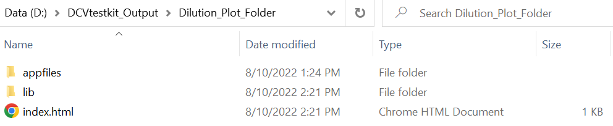
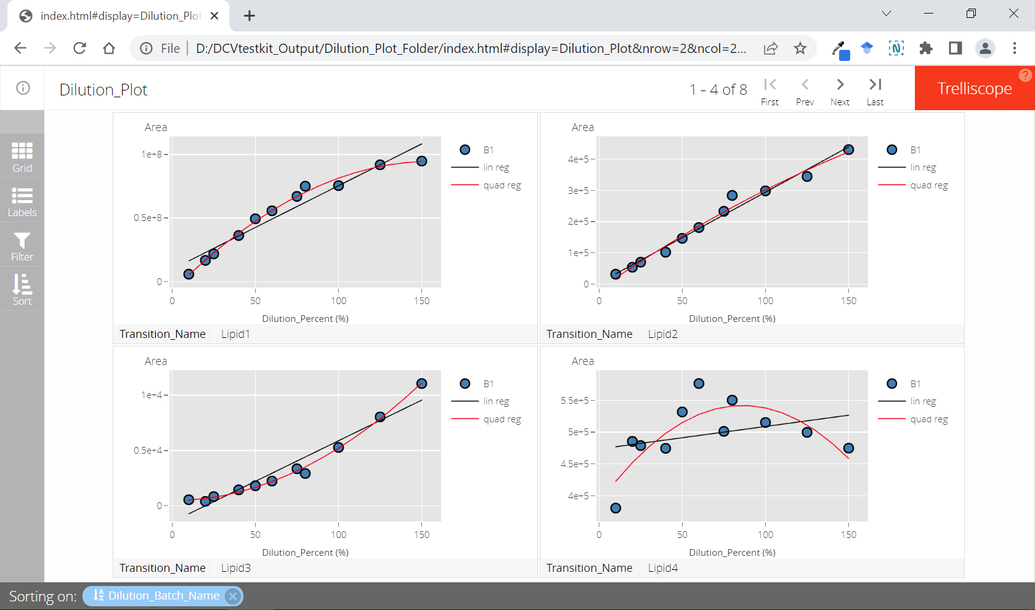

Slide 2
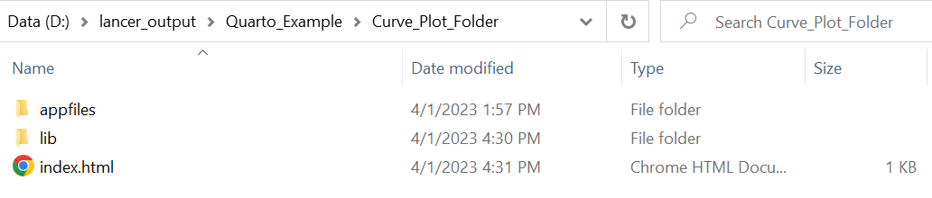
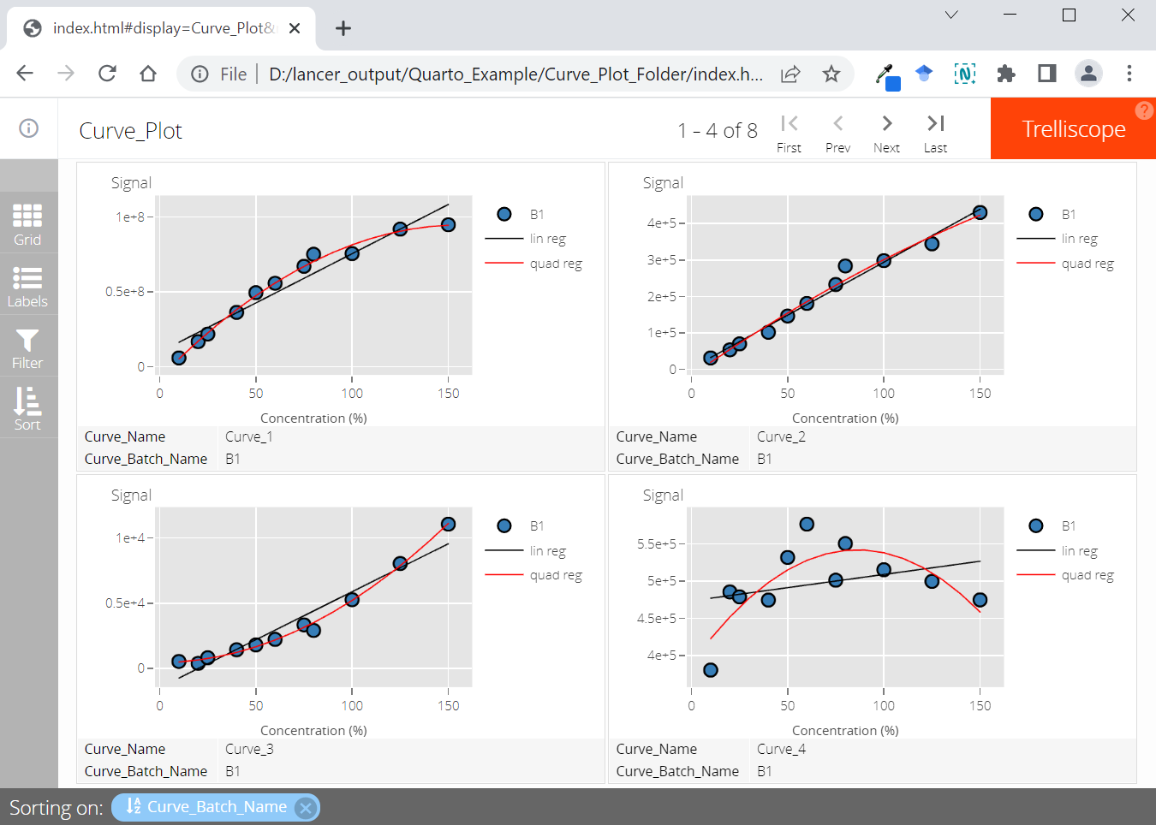

Slide 3
Is Linear
Identify non-linear relationship

Slide 4
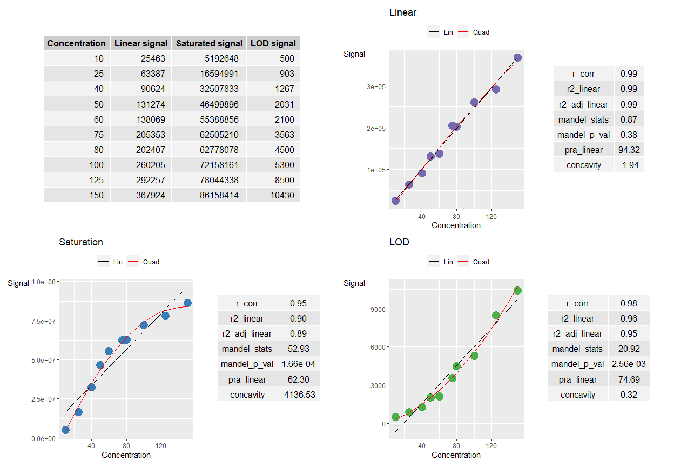
Concentration
Linear Regime
Saturation Regime
Noise Regime
Concentration
Linear Regime
Upper Non-linear Regime
Lower Non-linear Regime
Linear Regime
Saturation Regime
Upper Non-linear Regime
Noise Regime
Lower Non-linear Regime

Slide 5
Correlation Coefficient (R)
>= 0.8
Percent Residual Accuracy
>= 80%
Good Linearity
< 0.8
< 80%
Poor Linearity

Slide 6
Correlation Coefficient (R)
>= 0.8
Percent Residual Accuracy
>= 80%
Good Linearity
< 0.8
< 80%
Neg
Saturation
Mandel Fitting Test
p value
Concavity
< 0.05
Limit of Detection
>= 0.05
Pos
Poor Linearity

Slide 7
Workflow 1
Correlation Coefficient (R)
>= 0.8
Percent Residual Accuracy
>= 80%
Good Linearity
< 0.8
< 80%
Poor Linearity
Workflow 2
Correlation Coefficient (R)
>= 0.8
Percent Residual Accuracy
>= 80%
Good Linearity
< 0.8
< 80%
Neg
Saturation
Mandel Fitting Test
p value
Concavity
< 0.05
Limit of Detection
>= 0.05
Pos
Poor Linearity

Slide 8
Workflow 1
Correlation Coefficient (R)
>= 0.8
Percent Residual Accuracy
>= 80%
Good Linearity
< 0.8
< 80%
Poor Linearity
Workflow 2
Correlation Coefficient (R)
>= 0.8
Percent Residual Accuracy
>= 80%
Good Linearity
< 0.8
< 80%
Neg
Saturation Regime
Upper Non-linear Regime
Mandel Fitting Test
p value
Concavity
< 0.05
Noise Regime
Lower Non-linear Regime
>= 0.05
Pos
Poor Linearity

Slide 9
Correlation Coefficient (R)
>= 0.8
Percent Residual Accuracy
>= 80%
Good Linearity
< 0.8
< 80%
Neg
Saturation Regime
Mandel Fitting Test
p value
Concavity
< 0.05
Noise Regime
>= 0.05
Pos
Poor Linearity

Slide 10
Workflow 1
Correlation Coefficient (R)
>= 0.8
Percent Residual Accuracy
>= 80%
Good Linearity
< 0.8
< 80%
Poor Linearity
Workflow 2
Correlation Coefficient (R)
>= 0.8
Percent Residual Accuracy
>= 80%
Good Linearity
< 0.8
< 80%
Neg
Saturation Regime
Mandel Fitting Test
p value
Concavity
< 0.05
Noise Regime
>= 0.05
Pos
Poor Linearity

Slide 11
Input Data
Calculation
Curve Batch Annotation
Sample Name | Curve Batch Annotation
Curve Table
Sample Name | Curve Batch Annotation | Curve Name | Signal
create_curve_table
Curve Signal Data
Sample Name | Curve 1 | Curve 2
 | Signal
summarise_curve_table
Curve Summary Table
Curve Name | Curve Batch Annotation | Curve Statistics Summary
evaluate_linearity
Curve Name | Curve Batch Annotation | Curve Statistics Summary
 |  | Grouping Results | Statistics Summary
write_summary_excel
Curve Plotting
Static
Interactive
Report Results
Excel File
Curve Summary Table |  |  | ggplot Figures
Curve Name | Curve Batch Annotation | Curve Statistics Summary | Static Figures
add_ggplot_panel
view_ggplot_pdf
PDF File
convert_to_cog
HTML Folder
Curve Summary Table |  |  | plotly Figures
Curve Name | Curve Batch Annotation | Curve Statistics Summary | Interactive Figures
Trellis Visualisation
Cognostics Id |  | Cognostics Table | Panel
Curve Name | Curve Batch Annotation | Curve Statistics Summary | Figures
add_plotly_panel
convert_to_cog
view_trellis_html

Slide 12
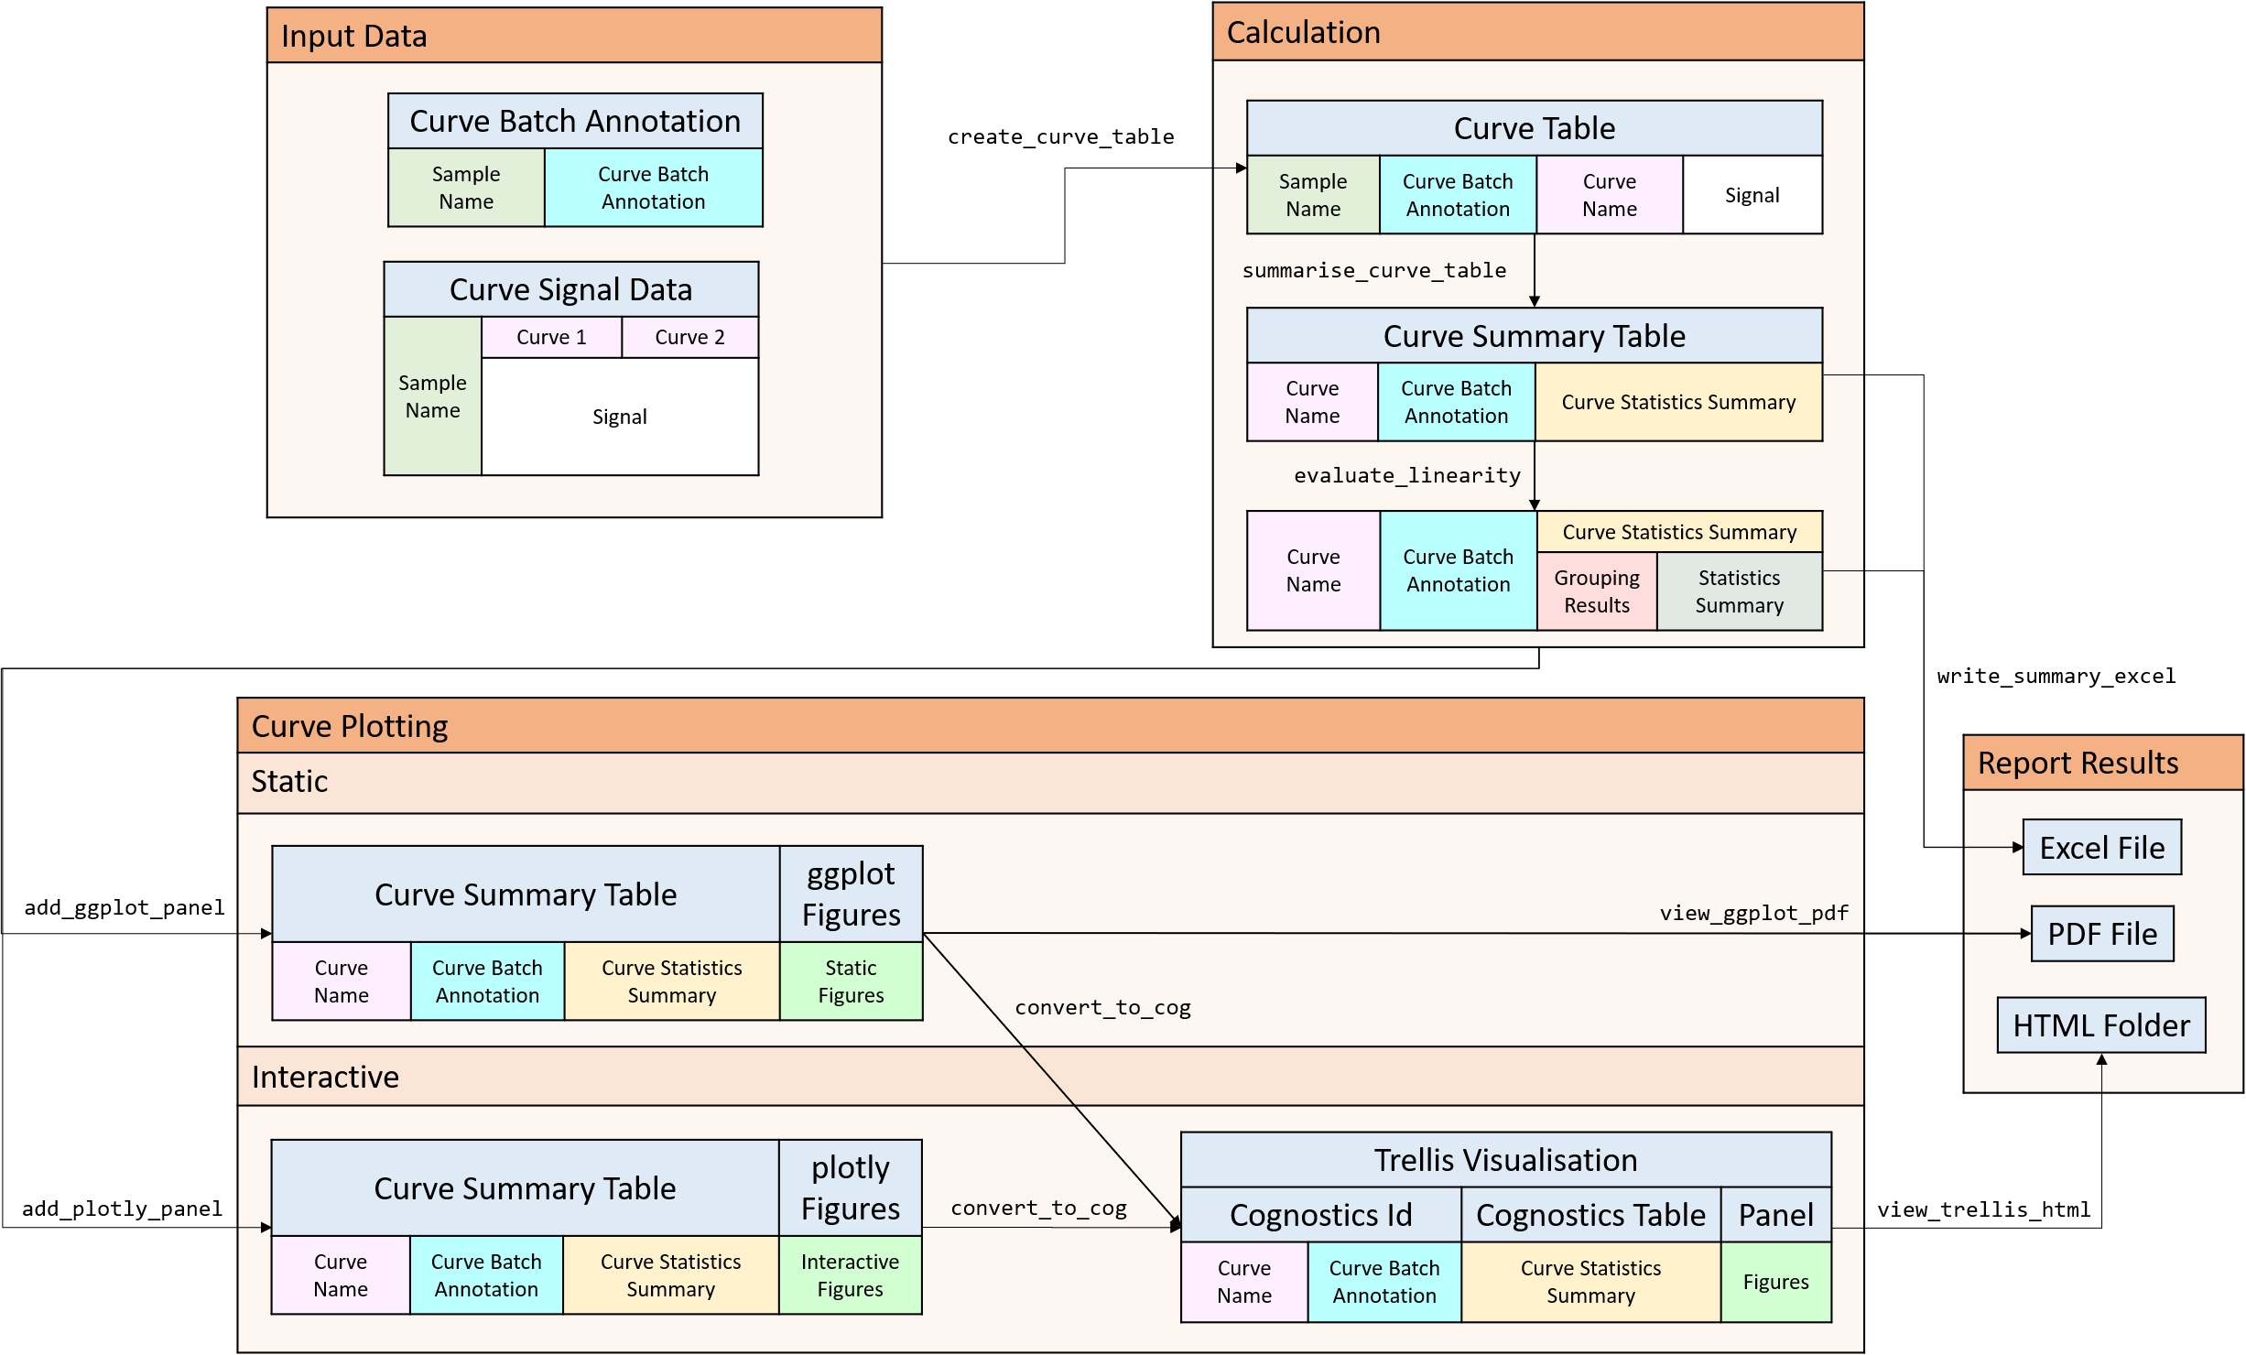

Slide 13
Input Data
Calculation
Curve Annotation
Sample Name | Curve Annotation
Curve Table
Sample Name | Curve Annotation | Curve Name | Signal
create_curve_table
Curve Signal Data
Sample Name | Curve 1 | Curve 2
 | Signal
summarise_curve_table
Curve Summary Table
Curve Name | Curve Annotation | Curve Statistics Summary
evaluate_linearity
Curve Name | Curve Annotation | Curve Statistics Summary
 |  | Grouping Results | Statistics Summary
write_summary_excel
Curve Plotting
Static
Interactive
Report Results
Excel File
Curve Summary Table |  |  | ggplot Figures
Curve Name | Curve Annotation | Curve Statistics Summary | Static Figures
add_ggplot_panel
view_ggplot_pdf
PDF File
convert_to_cog
HTML Folder
Curve Summary Table |  |  | plotly Figures
Curve Name | Curve Annotation | Curve Statistics Summary | Interactive Figures
Trellis Visualisation
Cognostics Id |  | Cognostics Table | Panel
Curve Name | Curve Annotation | Curve Statistics Summary | Figures
add_plotly_panel
convert_to_cog
view_trellis_html

Slide 14
Input Data
Calculation
Dilution Annotation
Sample Name | Dilution Annotation
Dilution Table
Sample Name | Dilution Annotation | Transition Name | Signal
create_dilution_table
Transition Signal Data
Sample Name | Transition 1 | Transition 2
 | Signal
summarise_dilution_table
Dilution Summary Table
Transition Name | Dilution Annotation | Dilution Statistics Summary
evaluate_linearity
Transition Name | Dilution Annotation | Dilution Statistics Summary
 |  | Grouping Results | Statistics Summary
write_summary_excel
Dilution Curve Plotting
Static
Interactive
Report Results
Excel File
Dilution Summary Table |  |  | ggplot Figures
Transition Name | Dilution Annotation | Dilution Statistics Summary | Static Figures
add_ggplot_panel
view_ggplot_pdf
PDF File
convert_to_cog
HTML Folder
Dilution Summary Table |  |  | plotly Figures
Transition Name | Dilution Annotation | Dilution Statistics Summary | Interactive Figures
Trellis Visualisation
Cognostics Id |  | Cognostics Table | Panel
Transition Name | Dilution Annotation | Dilution Statistics Summary | Figures
add_plotly_panel
convert_to_cog
view_trellis_html

